Slide 1
How to Give a Great Scientific Presentation
Engage, Inform, and Impress Your Audience

Slide 2
Schedule
April 21st/April 28th – First Presentation Session
May 11th – Abstract Submission
June 24th – Project Day (Second Presentation + Posters)
August 15th – Final Report Submission

Slide 3
Abstract Guidelines
Used by examiners on Project Day
Clear format (see course website)
12-line maximum (single paragraph)
No references, figures, or tables

Slide 4
Why Good Presentations Matter
A great presentation makes complex ideas understandable
It helps you connect with your audience
Poor slides can make even great research seem boring
Your goal: Clarity, engagement, and impact!

Slide 5
Presenting is Nothing More Than Storytelling
Every great presentation follows a narrative arc
Engage your audience with a clear beginning, middle, and end
Use real-life examples to make your research relatable
Your audience should feel like they are discovering something with you

Slide 6
Common Mistakes in Presentations
Too much text on slides
Reading directly from the slides
Overuse of animations and colors
Lack of clear structure and transitions
No interaction with the audience

Slide 7
Structure of a Great Presentation
1. Title Slide
2. Introduction (Why this topic matters)
3. Research Question & Objectives
4. Methods & Approach
5. Key Findings & Results
6. Discussion & Implications
7. Conclusion & Next Steps
8. Q&A Session

Slide 8
Bad Slide Example: Too Much Text
Scientific presentations should be clear and concise. However, if you put too much text on a slide, the audience will stop listening to you and start reading instead. You should avoid putting paragraphs of information on one slide. For example, this slide will quickly get the audience to check their phones because nobody can listen to someone talk and read a book at the same time. It gets even worse with equations.

Slide 9
Good Slide Example: Clean & Focused
Use bullet points instead of paragraphs
Include a relevant image or diagram
Keep key messages short and impactful

Slide 10
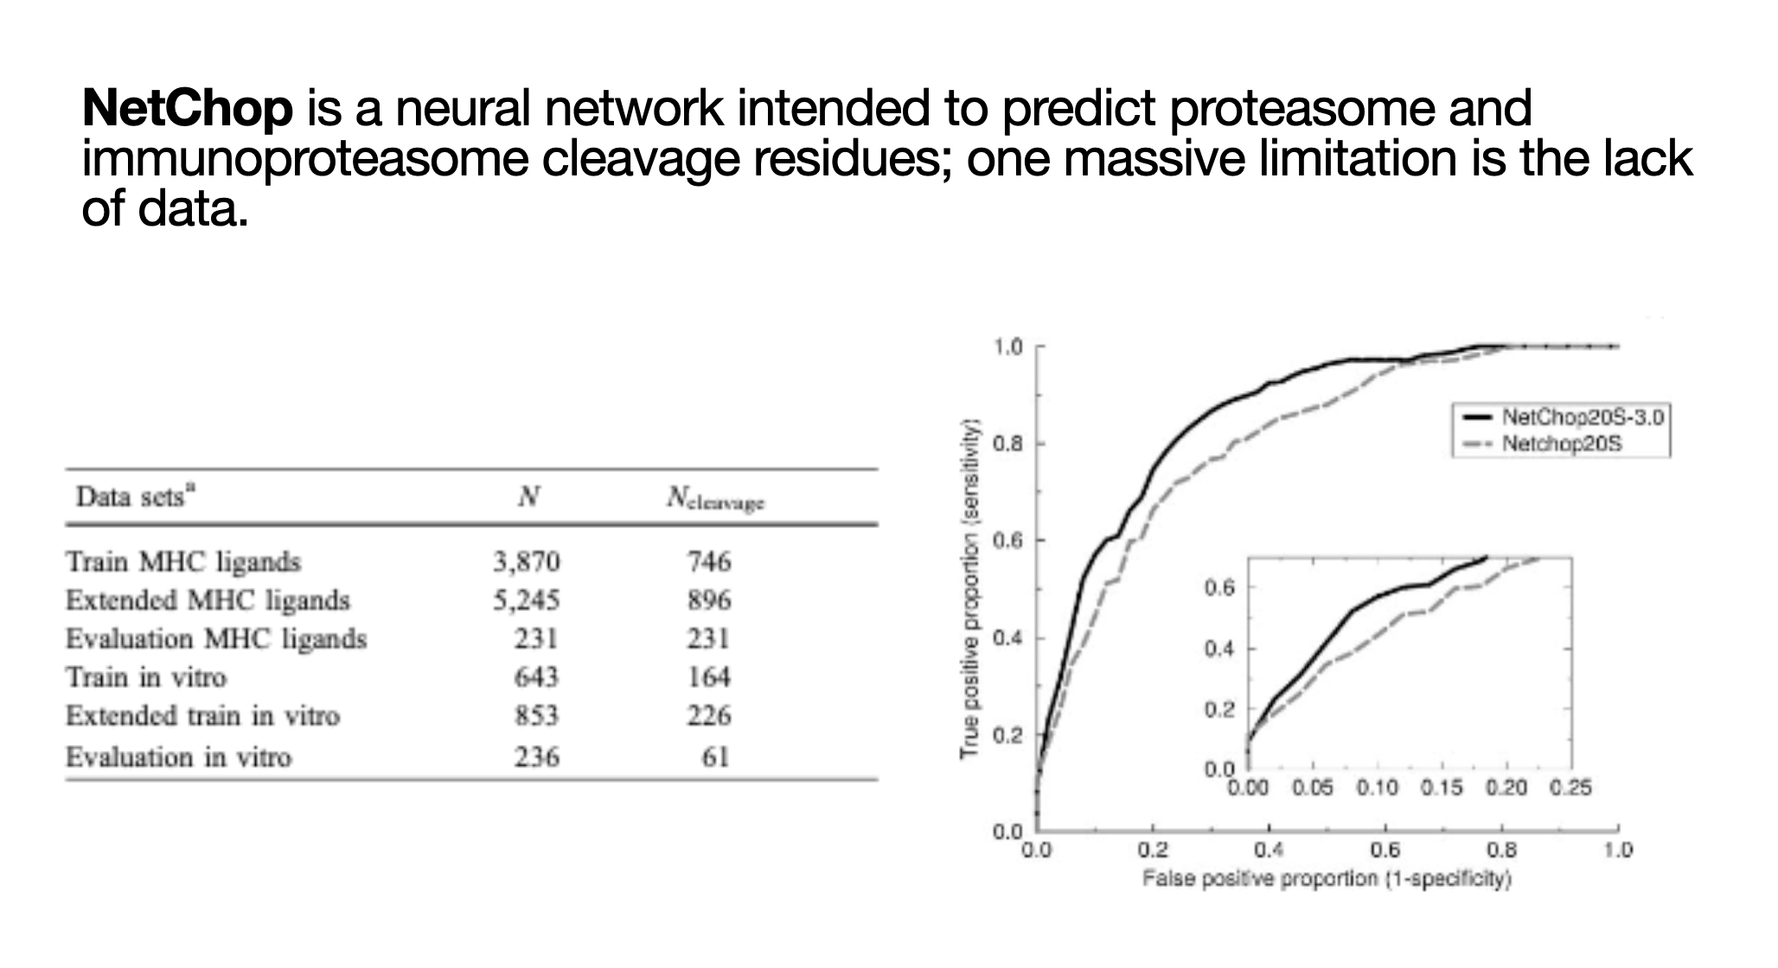

Slide 11
Using Visuals Effectively
Use charts and graphs instead of raw data tables
Avoid pixelated or irrelevant images
Keep colors consistent and professional
Label all figures and make text readable

Slide 12
Pause Here: Let the Audience Refocus

Slide 13
Handling Questions
Listen carefully before responding
Repeat the question if needed
If you don’t know the answer, admit it and suggest how to find out
Stay calm and confident

Slide 14
Using Transitions Effectively
Avoid excessive slide transitions (keep it simple)
Use pauses to indicate topic changes
Verbally signal when moving to a new idea
Use blank slides to regain attention

Slide 15
How to End Strong
Summarize your main findings
Reinforce why your research matters
End with a thought-provoking statement or call to action

Slide 16
Good vs. Bad Graphs
Avoid cluttered or confusing graphs
Use appropriate axis labels and scales
Highlight key data points with annotations

Slide 17
How to Keep Your Audience Engaged
Ask questions throughout your talk
Use humor when appropriate
Tell a short, relevant story to illustrate a point
Make eye contact and avoid monotone speaking

Slide 18
Bad Example: Too Many Effects
Avoid unnecessary animations
Don’t use distracting fonts or colors
Keep your style professional and consistent

Slide 19
Good Example: Clean & Professional
Stick to a simple, readable font
Use a consistent color scheme
Ensure slides are visually balanced

Slide 20
Overcoming Presentation Anxiety
Practice multiple times
Record yourself and review performance
Breathe deeply and pace yourself
Focus on the message, not the fear

Slide 21
Common Questions You Might Be Asked
What are the limitations of your study?
How does your research compare to previous work?
What would you do differently in future studies?
How can this research be applied in real life?

Slide 22
Any Final Questions?

